Slide 1
Image Processing Tool
Chapter 10
Dr. Uyen Nguyen

Slide 2
Image Classes in Matlab
For Color
RGB Image
Indexed Image
For Gray Scale
Intensity Image
Binary Image

Slide 3
RGB Images
RGB = imread('peppers.png');
Whos
RGB 384x512x3
RGB(:,:,1) is Red intensity
RGB(:,:,2) is Green intensity
RGB(:,:,3) is Blue intensity

Slide 4
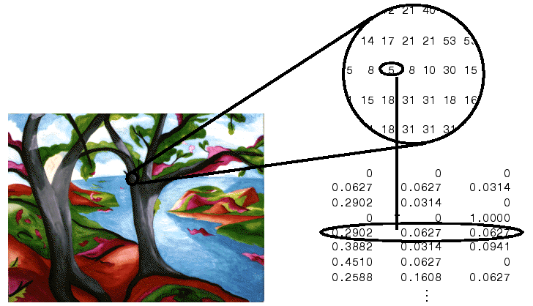
Indexed Images
RGB = imread('peppers.png');
[X,map]=rgb2ind(RGB,128);
Whos
RGB 384x512x3 589824 uint8
X 384x512 196608 uint8
map 128x3 3072 double
Image(X)
Colormap(map)
Colormap(hot)
X is the indexed image
Map is the color index
We can use different colormap to plot the color image
(Winter, Summer, Hot, Cool, pink)

Slide 5
Intensity Image
grayX=rgb2gray(RGB);
Imshow(grayX)
Whos
grayX 384x512 196608 uint8
binX=imbinarize(grayX);
Imshow(binX)
Whos
binX 384x512 196608 logical
Binary Image

Slide 6
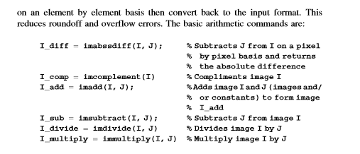
Basic arithmetic operations (chapter 10, page 286)

Slide 7
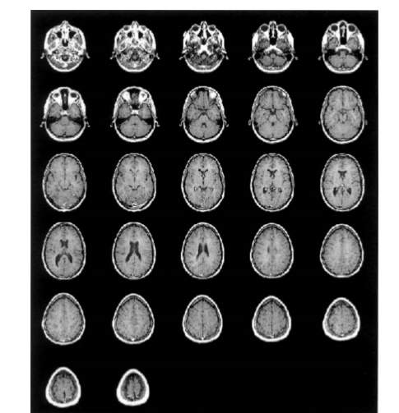
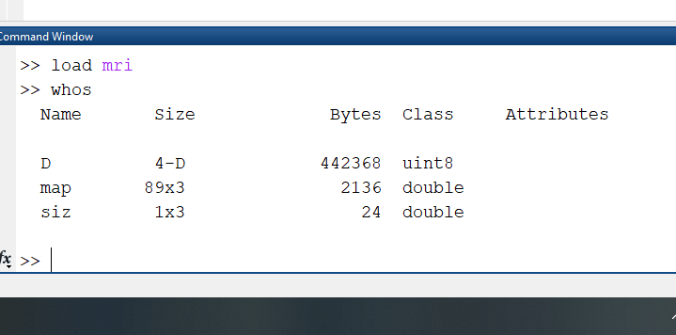
Example 10.4
Load mri
Whos
montage(D,map)

Slide 8
In chapter 10
mri = uint8(zeros(128,128,1,27));
for frame=1:27
[mri(:,:,:,frame),map] = imread('mri.tif',frame);
end
montage(mri,map)

Slide 9
Hot, cool, winter color map
montage(D,hot)
montage(D,winter)
montage(D,spring)

Slide 10
Example 10.4
Image(D(:,:,2))
Colormap(map)
Colormap hot
Note: The MRI image is an Indexed image
To perform mathematical operation we need to convert it into number (double).

Slide 11
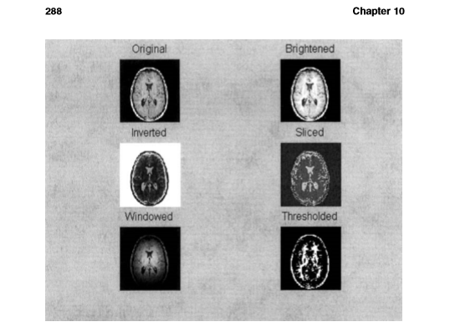
Example 10.4
1- Brightened the original image 15
(Use the immultiply command)
Original
Brightened

Slide 12
Example 10.4
1- Inverted
2- Sliced
3- Binary threshold
Sliced
Inverted
Binary (threshold)

Slide 13
Exercises In Class
Basic Image Import, Processing, and Export
Identifying Round Objects
Detect and Measure Circular Objects in an Image

Slide 14
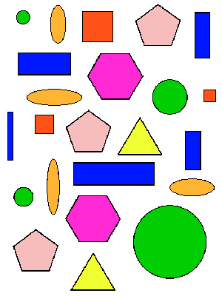
HW 1
Write a matlab code to determine the objects are the followings:
1- Circle
2- Triangle
3- Square
4- Rectangle

Slide 15
HW 2
Write a matlab code to determine the red circles and circle only the red circles.

